Slide 1
CS 419: Production Rendering Mirror Reflection
Eric Shaffer

Slide 2
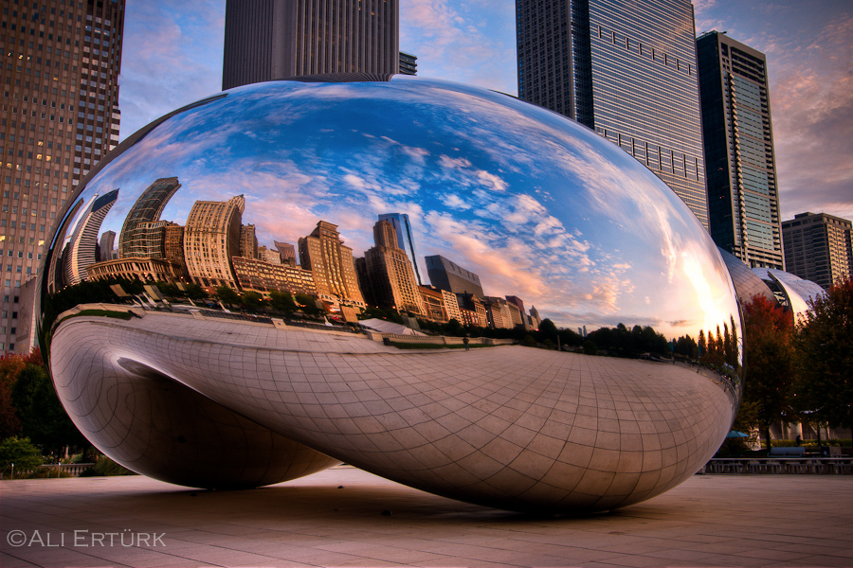
Objectives
Learn the core ideas behind the optics of mirrors
Understand how mirror reflection can be modeled in ray tracing
Be able to implement mirror reflection

Slide 3
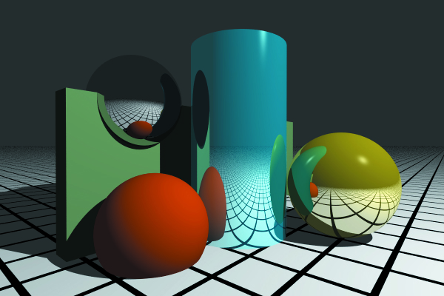
Reflection
Mirror reflection is an effect of indirect illumination
Up till now we have focused on direct illumination
Recursive ray-tracing technique first developed by Whitted (1980)
you will still sometimes see the term “Whitted-style ray-tracing” used
Goal: model specular-to-specular light transport with perfect reflection

Slide 4
Illumination Model
Indirect illumination can arrive from any direction
L_{r} is reflected light
L_{i} is incident radiance obtained by shooting ray r_{c} into the hemisphere above p
For now, we’ll only consider the special case of light obtained in the mirror reflection direction

Slide 5
Perfect Mirror Reflection

Slide 6
Perfect Mirror Reflection
For mirror reflection, incident radiance comes from a single direction

Slide 7
Perfect Mirror Reflection
Note that there is no cosine term for mirror reflection
There is no scattering
So the cross-sectional area is unchanged by reflection

Slide 8
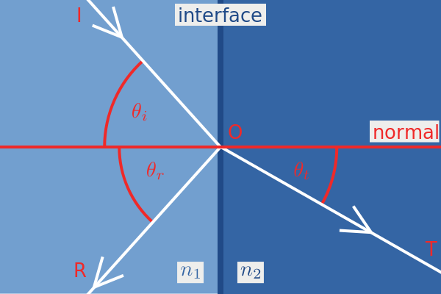
Mirror reflection BRDF
A physical approach for deriving a BRDF would use the Fresnel Equations
These describe the behavior of light moving between 2 different media
We’ll look at that later
For now we’ll just use a constant f_{r}=k_{r}c_{r} k is the reflection coefficient in [0,1] c is the reflection color more formally….you can define a function that is 0 whenever the light isn’t coming from the mirror reflection direction and is equal to k_{r}c_{r} when it is from that direction…

Slide 9
Multiple Reflections
Your reflection ray can
Hit nothing (returns background color)
Hit a light (returns emitted light)
Hit a non-reflective object at point p’
Need to compute and return direct illumination at p’
Hit a reflective object at p’
Compute direct illumination at p’ plus indirect, recurse into the scene…

Slide 10
Multiple Reflections
Hit a reflective object at p’
Compute direct illumination at p’
For area lights, this means Monte Carlo integration
Compute indirect illumination at p’ recursively
Need to use a recursion depth limit to stop at some point
Add the two together and return

Slide 11
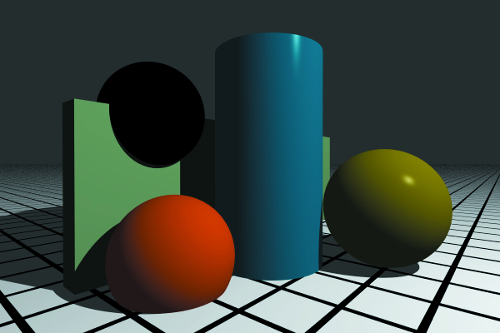
Examples
black sphere reflects no direct illumination
shows difference between recursion depth 0 and recursion depth 1

Slide 12
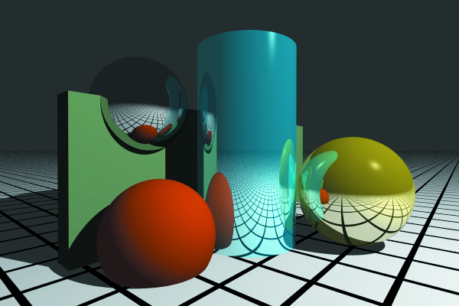
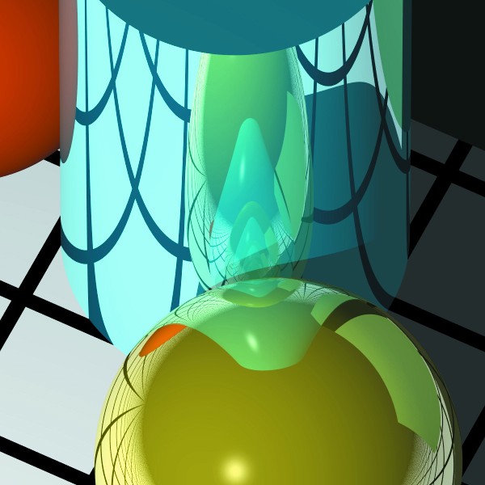
Examples
recursion depth = 10

Slide 13
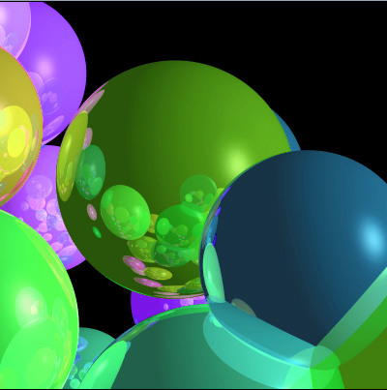
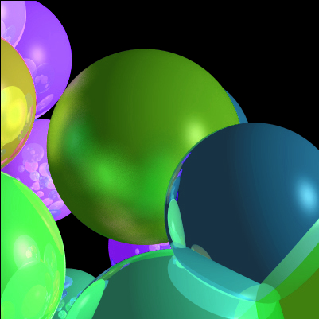
Specular Inconsistency

Slide 14
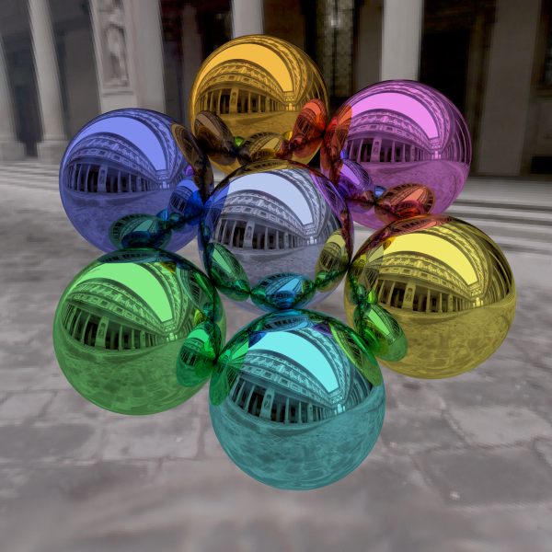
Colored Reflectors
k_{a}=k_{d}=k_{s}=0
only color is c_{r}

Slide 15
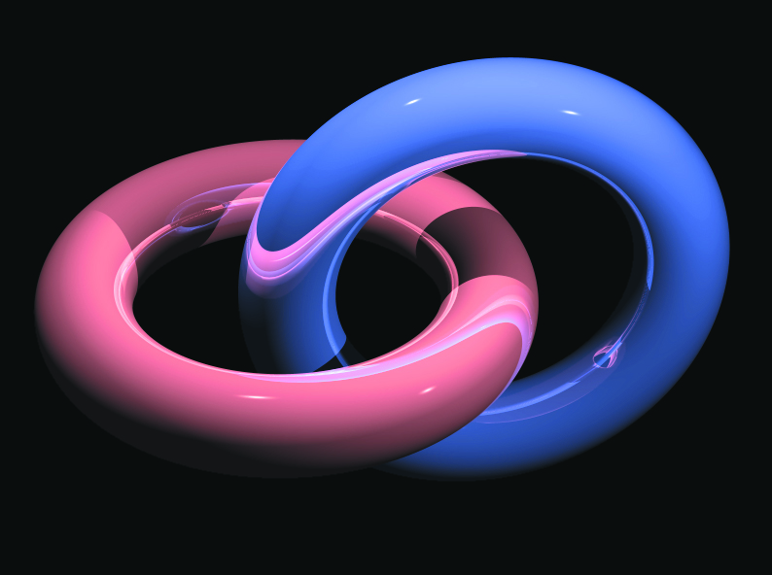
Self-Reflection

Slide 16
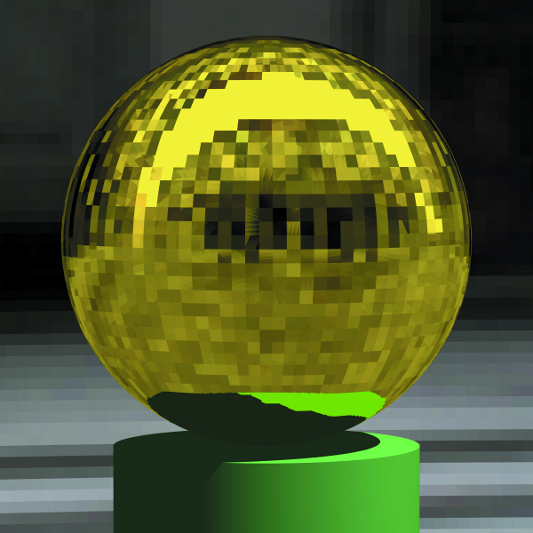
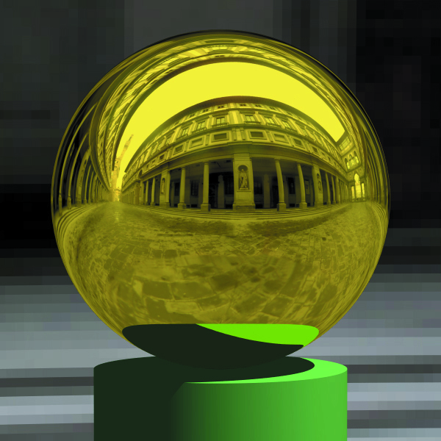
Reflective Meshes
Flat normals versus smooth change the appearance

Slide 17
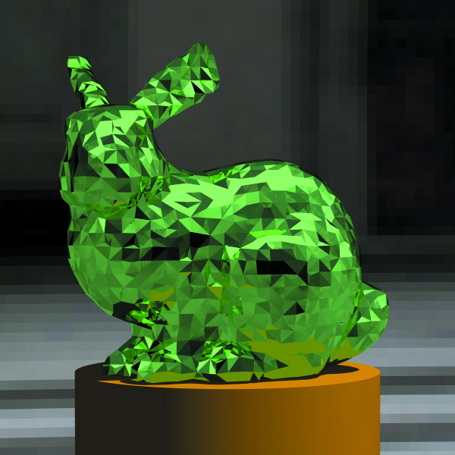
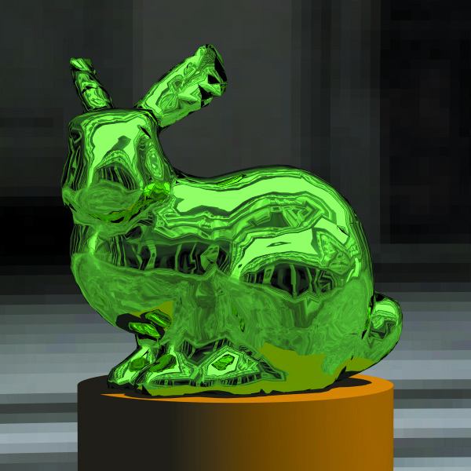
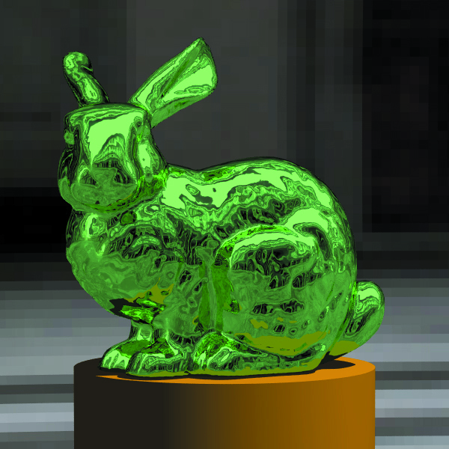
Reflective Meshes
Flat normals versus smooth change the appearance

